Slide 1
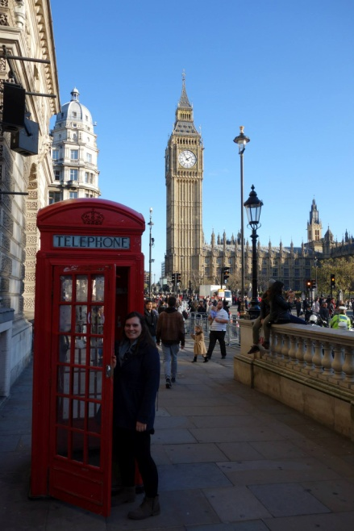
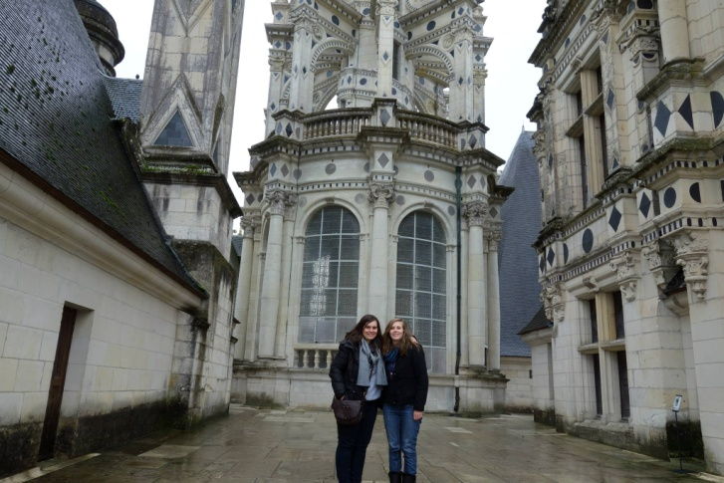
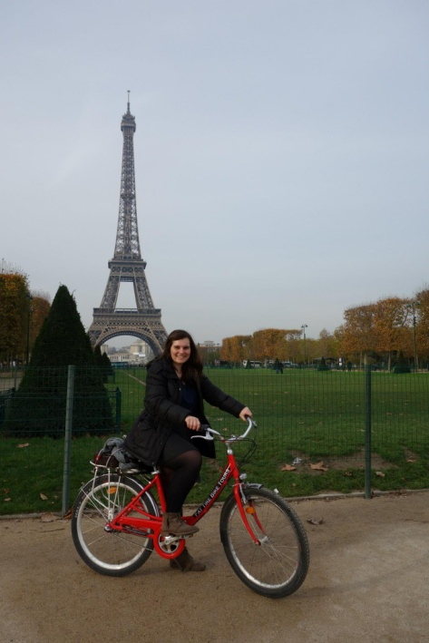
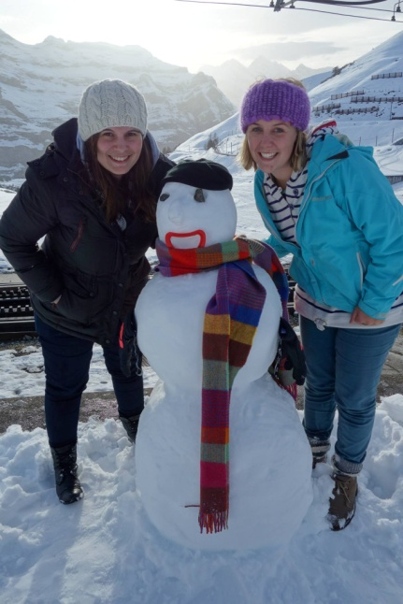
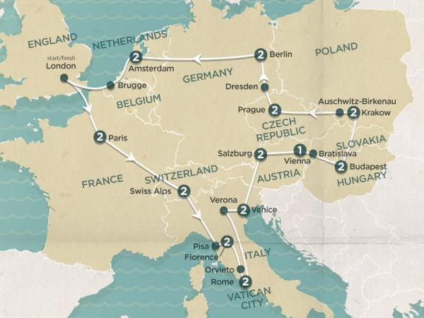
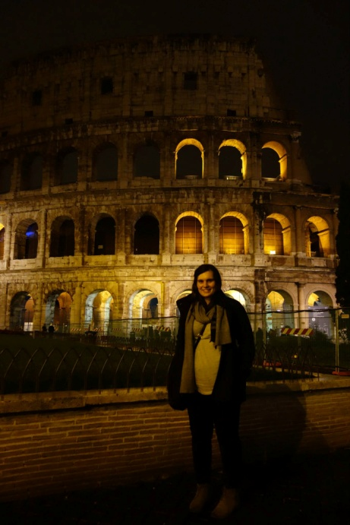

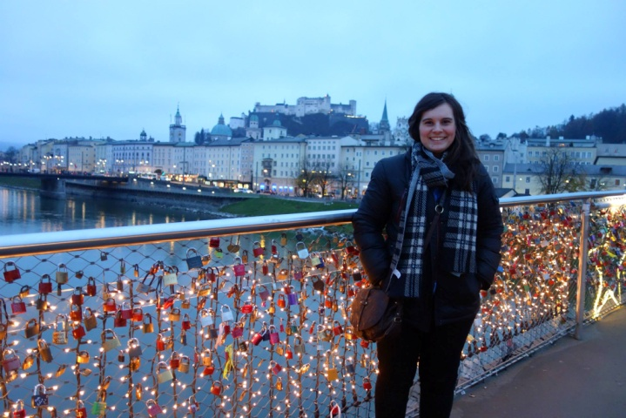
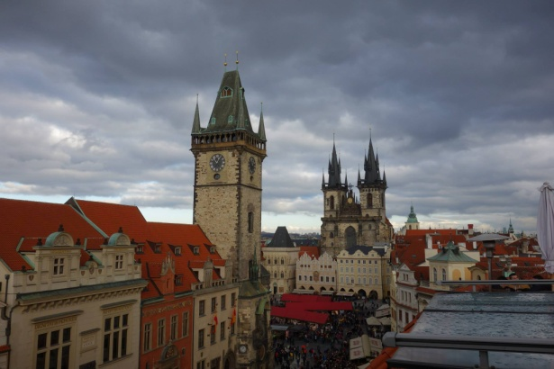
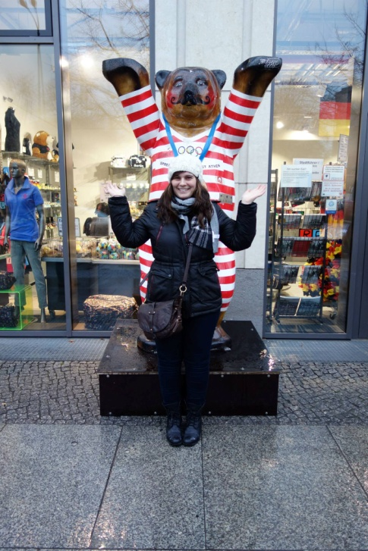
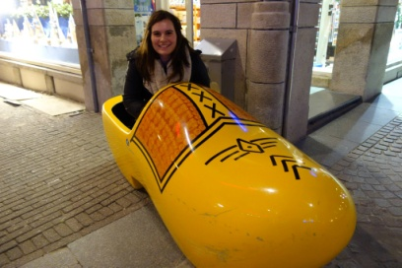
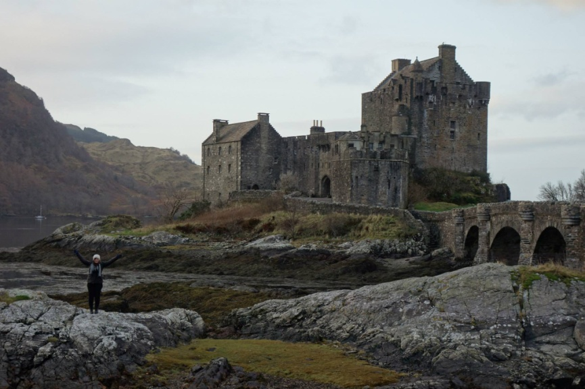


Slide 2
Cavin-2 and cavin-3 as tumour suppressors in prostate cancer
Lab Meeting
Amanda Oliver

Slide 3
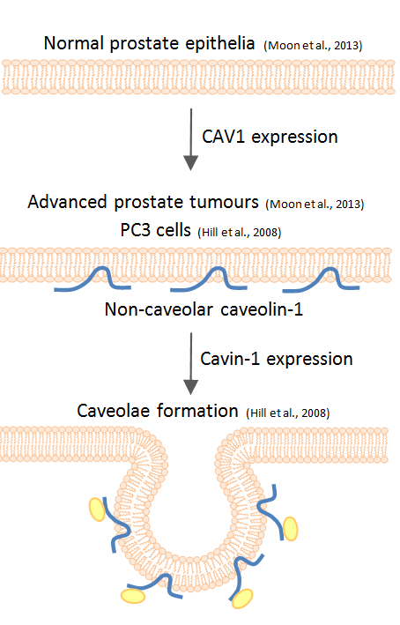
Caveolar proteins
Caveolae – small invaginations in lipid rafts
Caveolins and cavins involved in formation
Caveolin-1 (CAV1) and cavin-1 are essential for formation (Hill et al. 2008)
CAV1 expression increases tumourigenesis in prostate cancer cells
Cavin-1 attenuates CAV1 tumour promotion (Moon et al. 2013)

Slide 4
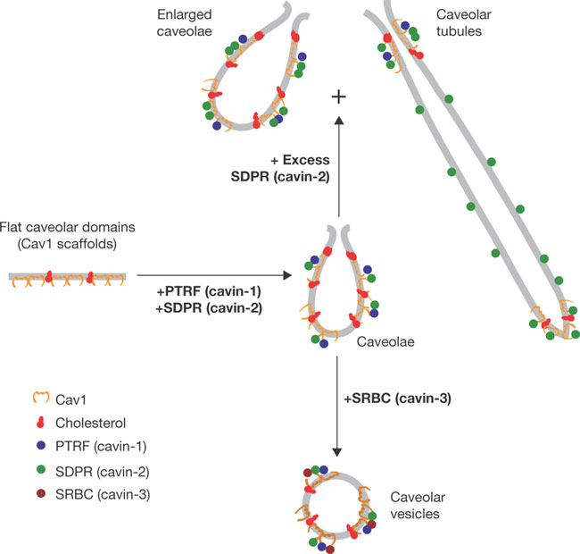
Cavin-2 and -3 in cancer
In caveolae:
Cavin-2 involved in tubulation and elongation
Cavin-3 involved in internalisation and trafficking
Both are down regulated in various cancers
Cavin-2 expression (mRNA and protein levels) down regulated in prostate cancer tissues compared to normal (Altintas et al., PLoS One 2013, Li et al., Cancer Science 2008)
Cavin-3 downregulated by promoter hypermethylation in prostate cancer cell lines compared to normal prostate epithelia (Mishra et al., Mol. Cancer Ther. 2010)

Slide 5
Cavin-2 downregulated in stroma
Summary of immunohistochemistry of SDPR/cavin-2 Chi-square test
Epithelial SDPR/cavin-2 (p=0.0485)
IHC score |  | 0 | 1 | 2 | p-value
Adjacent Normal |  | 202 (86.0%) | 32 (13.6%) | 1 (0.4%)
BPH |  | 231 (89.9%) | 23 (8.9%) | 3 (1.2%) | 0.1792
PCa | ≤ Gleason grade III | 228 (85.4%) | 31 (11.6%) | 8 (3.0%) | 0.0816
 | ≥ Gleason grade IV | 211 (81.5%) | 40 (15.4%) | 8 (3.1%) | 0.0680
Stromal SDPR/cavin-2 (p<0.0001)
IHC score |  | 0 | 1 | 2 | p-value
Adjacent Normal |  | 0 (0.0%) | 35 (13.9%) | 217 (86.1%)
BPH |  | 7 (2.7%) | 52 (20.6%) | 199 (77.1%) | 0.0040
PCa | ≤ Gleason grade III | 44 (15.9%) | 102 (36.8%) | 131 (47.3%) | <0.0001
 | ≥ Gleason grade IV | 68 (27.0%) | 127 (50.4%) | 57 (22.6%) | <0.0001
Sunny

Slide 6
Cavin-3 downregulated in stroma and epithelia
Summary of immunohistochemistry of PRKCDBP/cavin-3 Chi-square test
Epithelial PRKCDBP/cavin-3 (p<0.0001)
IHC score |  | 0 | 1 | 2 | p-value
Adjacent Normal |  | 155 (65.4%) | 73 (30.8%) | 9 (3.8%)
BPH |  | 185 (72.8%) | 62 (24.4%) | 7 (2.8%) | 0.2010
PCa | ≤ Gleason grade III | 215 (82.1%) | 40 (15.3%) | 7 (2.7%) | 0.0001
 | ≥ Gleason grade IV | 217 (85.4%) | 27 (10.6%) | 10 (3.9%) | <0.0001
Stromal PRKCDBP/cavin-3 (p<0.0001)
IHC score |  | 0 | 1 | 2 | p-value
Adjacent Normal |  | 0 (0.0%) | 36 (14.3%) | 216 (85.7%)
BPH |  | 1 (0.4%) | 65 (25.2%) | 192 (74.4%) | 0.0048
PCa | ≤ Gleason grade III | 28 (10.6%) | 129 (48.9%) | 107 (40.5%) | <0.0001
 | ≥ Gleason grade IV | 40 (15.2%) | 173 (65.5%) | 51 (19.3%) | <0.0001
Sunny

Slide 7
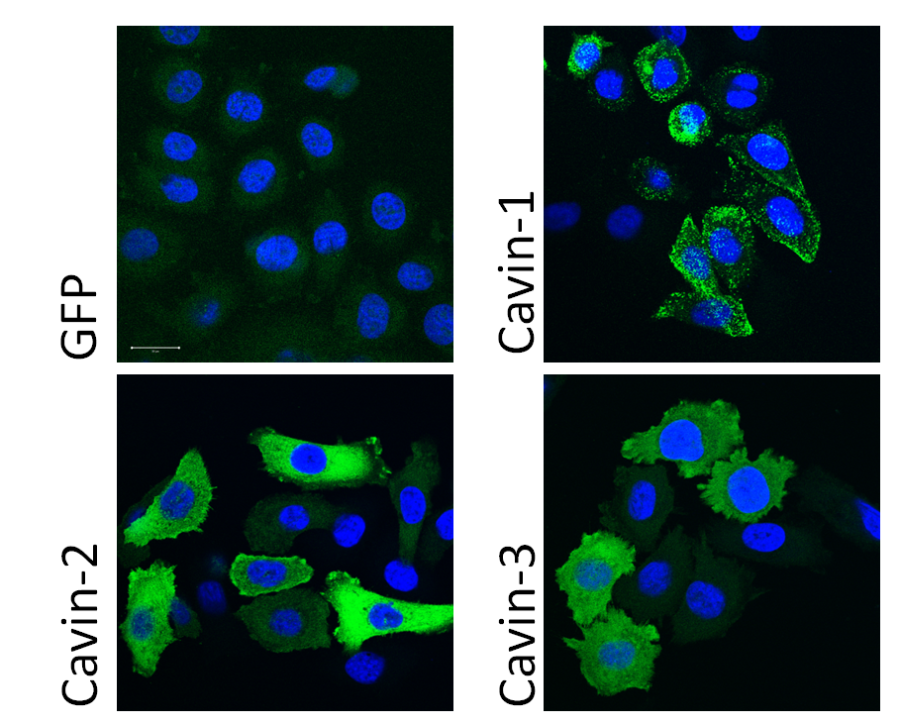
PC3 cells
Androgen-independent, metastatic prostate cancer cell line
Express caveolin-1 but no cavins

Slide 8
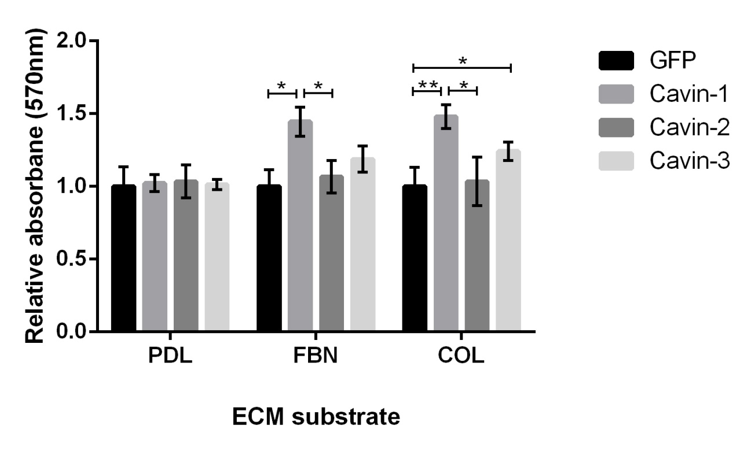
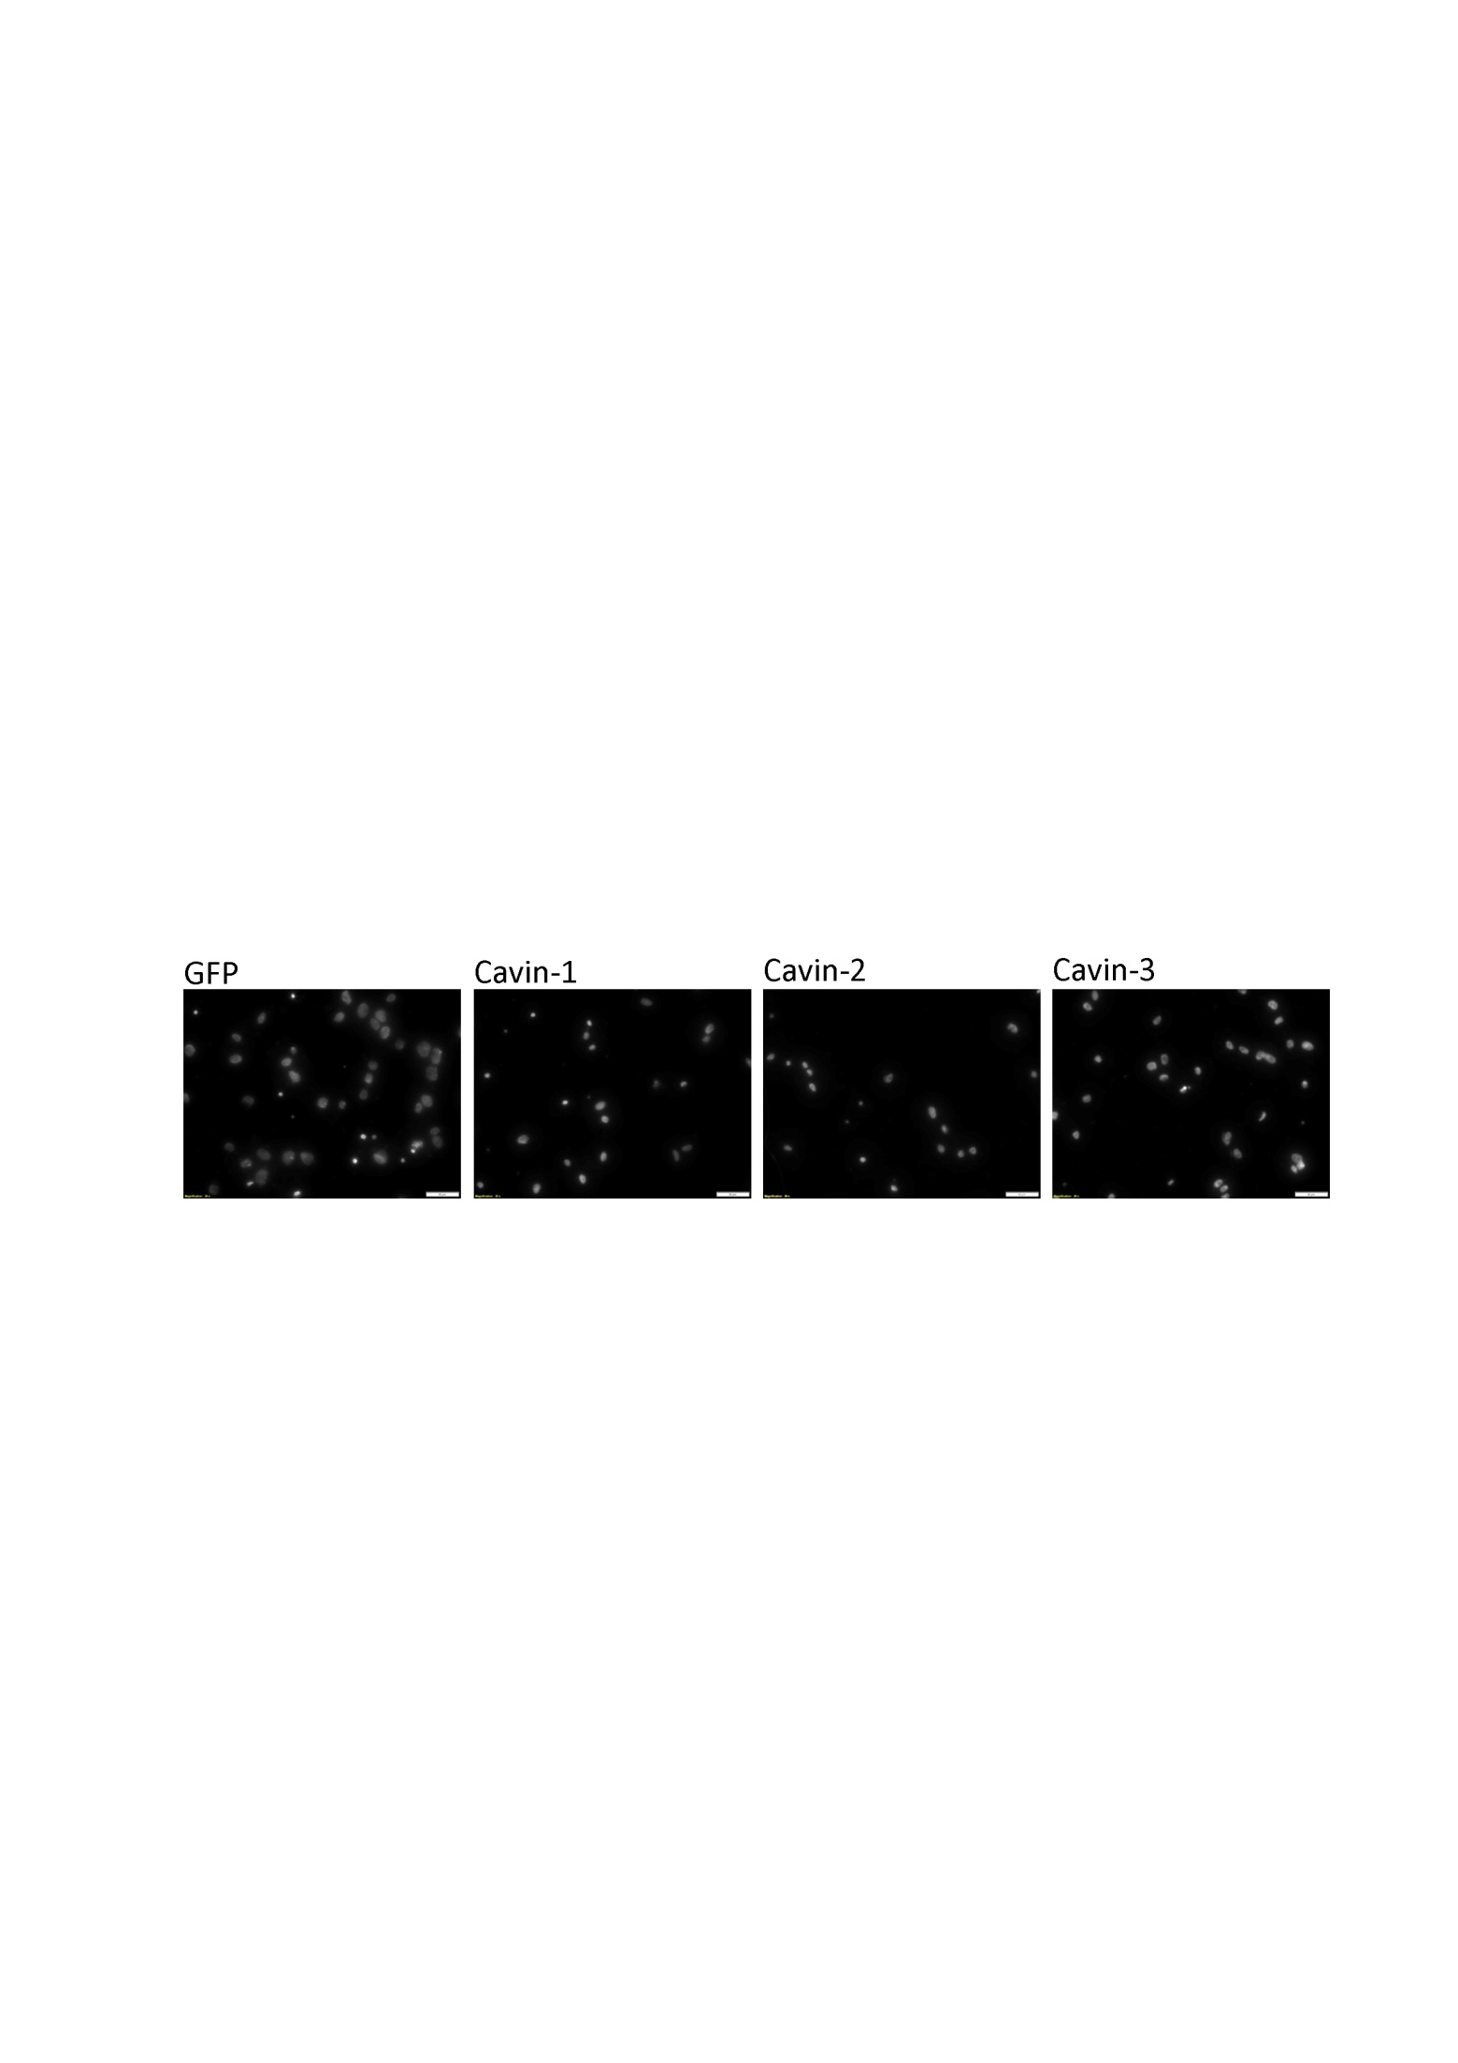
Cavin-2 and -3 decrease migration in PC3 cells
Migration Assay
Adhesion Assay

Slide 9
Decreased proliferation in PC3 cells
Harriet &
Sunny

Slide 10
Reduced anchorage independent growth in PC3 cells
Harriet &
Sunny

Slide 11
Cavin expression in prostate cancer cell lines
Sunny

Slide 12
Non-caveolar roles of cavin-2 and cavin-3
Cavin-2
Cavin-3
Binds to PKCα
Expression induced by serum starvation
miR206 suppresses cavin-2 and suppresses migration and proliferation in HEK 293T and SH SY5Y cells
Binds to PKCδ
Expression induced by serum starvation
Involved in circadian oscillation
Cavin-3 increases pERK and decreases pAkt in human fibroblasts
Cell cycle progression?

Slide 13
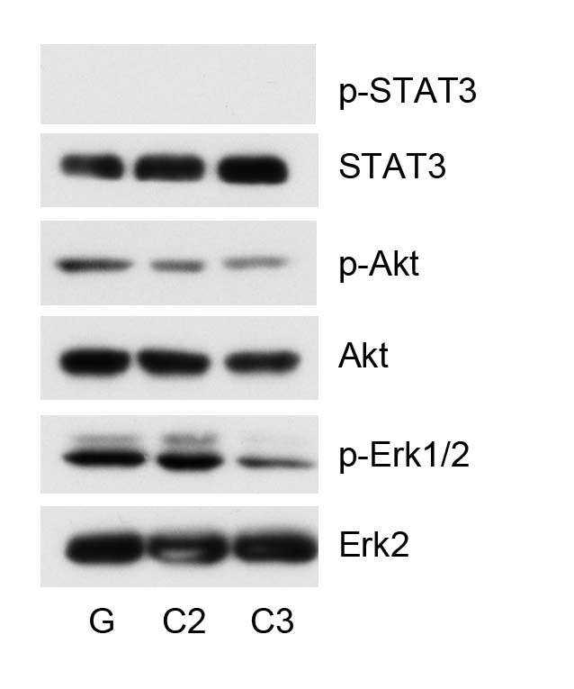
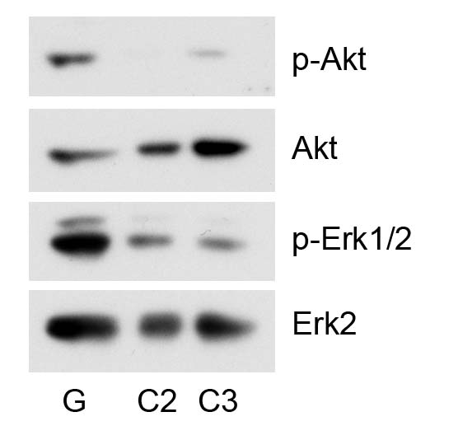
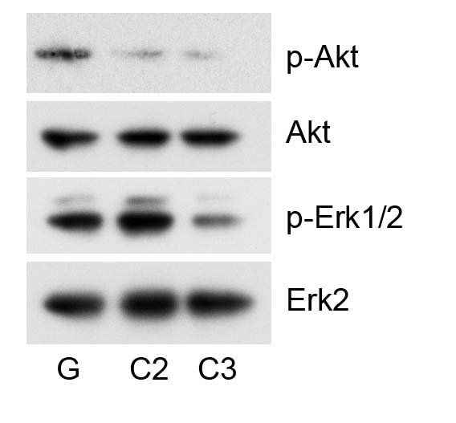
pERK and pAkt
3 hours serum starvation → serum (10% FBS/RPMI for 15 min) → total cell lysates
Exp. 1
Exp. 2
Exp. 3
G: GFP control | C2: cavin-2 | C3: cavin-3
Cavin-2 decreased pAkt
Cavin-3 decreased pAkt and pERK-1/2
Sunny

Slide 14
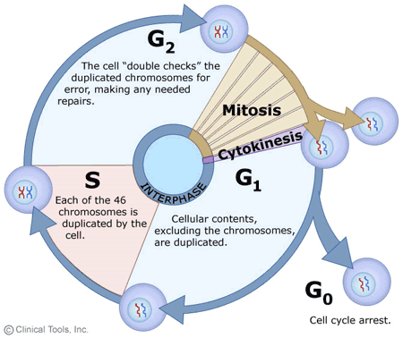
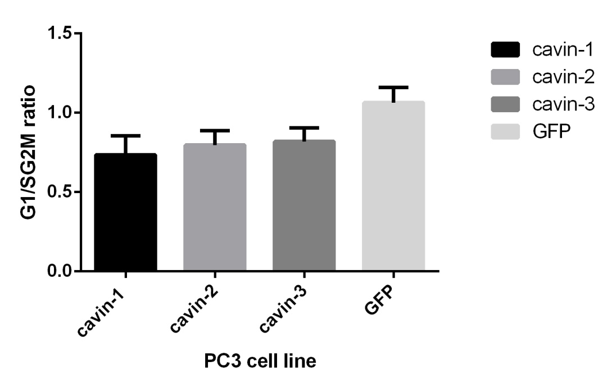
Cell cycle progression
Number of cells
Gene
Sunny
Duka and Ramya (ARVEC)

Slide 15
LNCaP cells
Androgen-sensitive, derived from lymph node metastasis
Less aggressive than PC3 cells
Do not express any caveolins or cavins
Expect similar results to PC3 cells when over-expressing cavin-2 and cavin-3

Slide 16
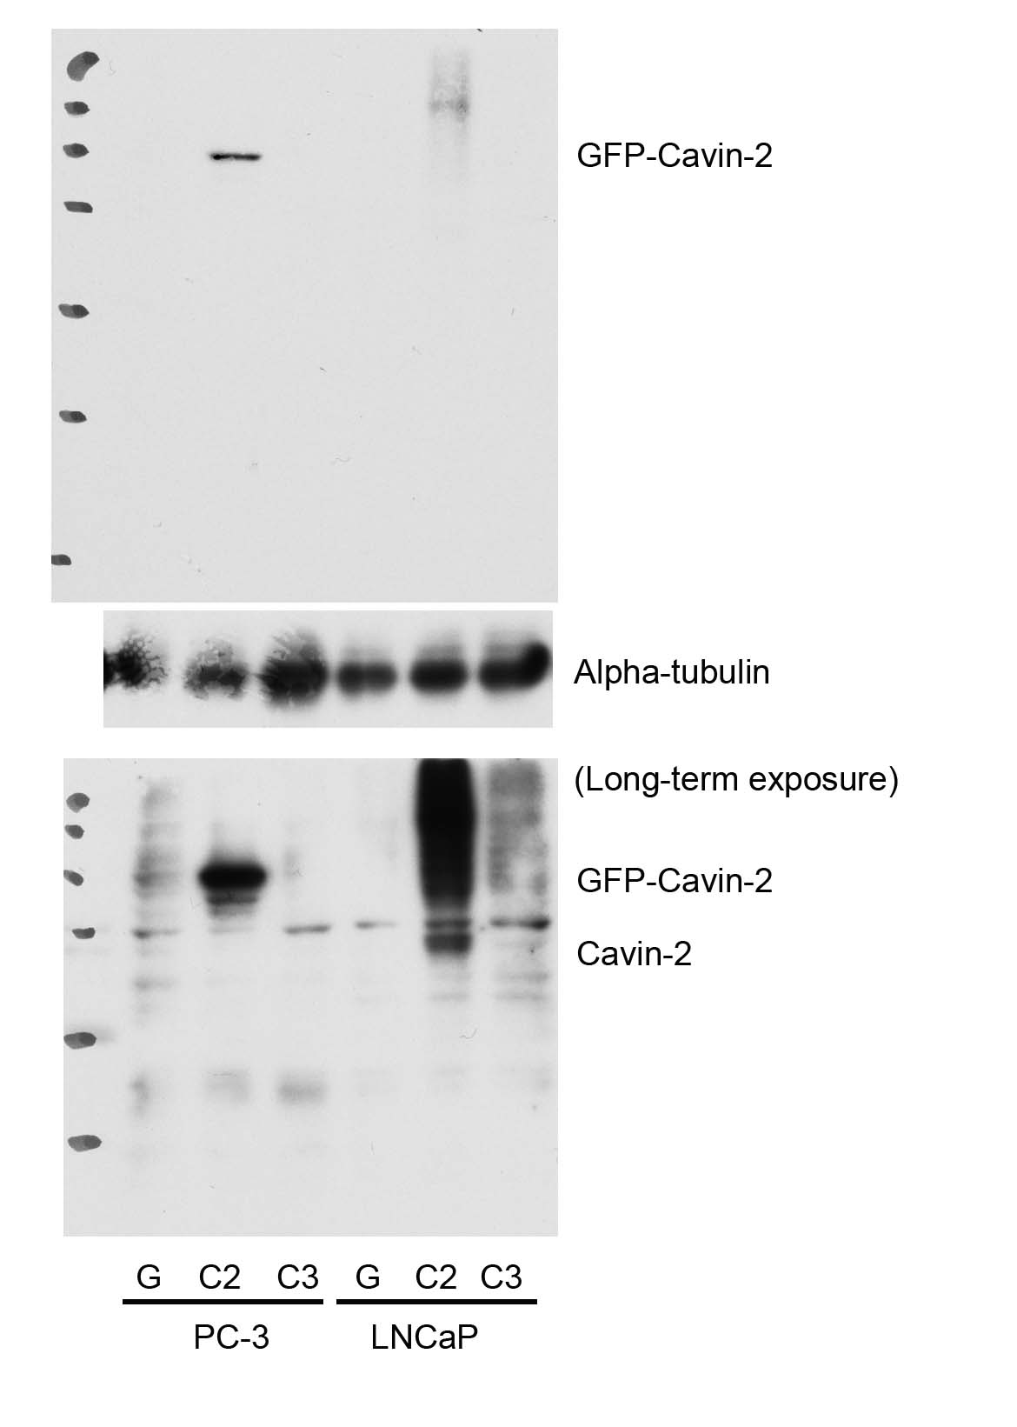
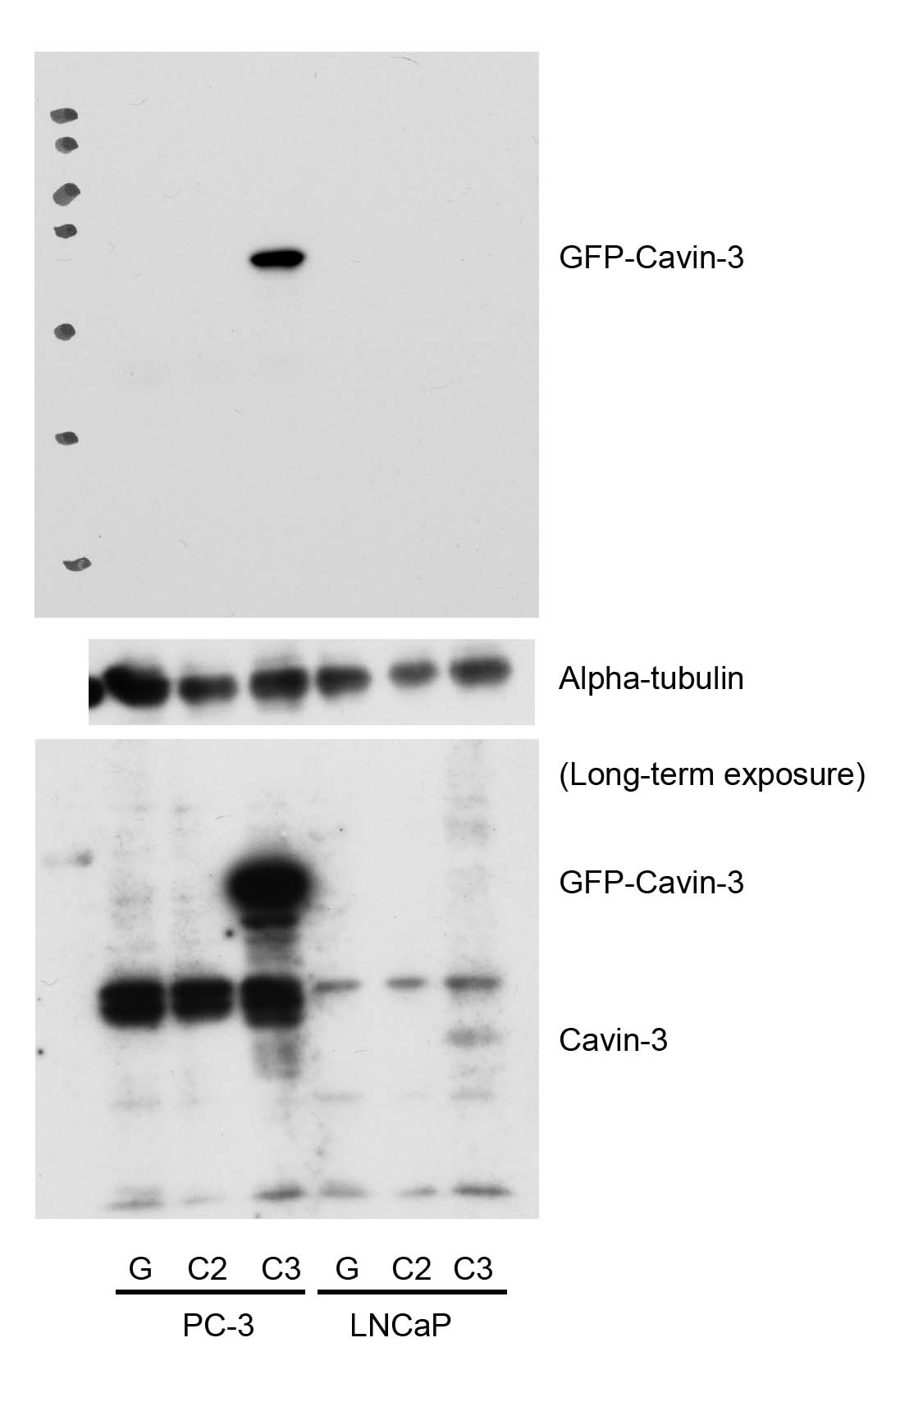
LNCaP stable cell line generation
Very low expression using lentivirus transduction
Sunny

Slide 17
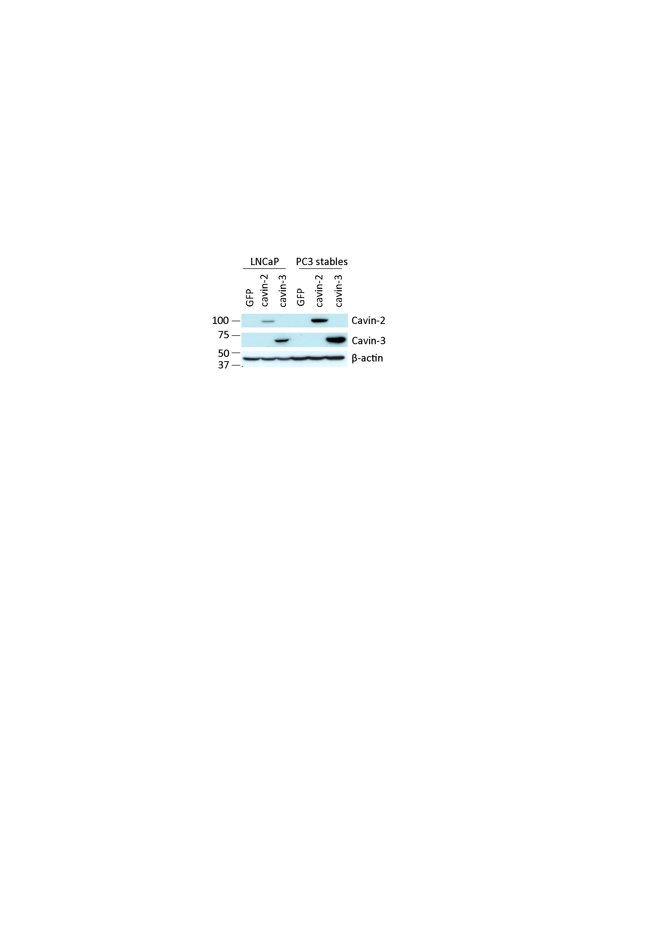
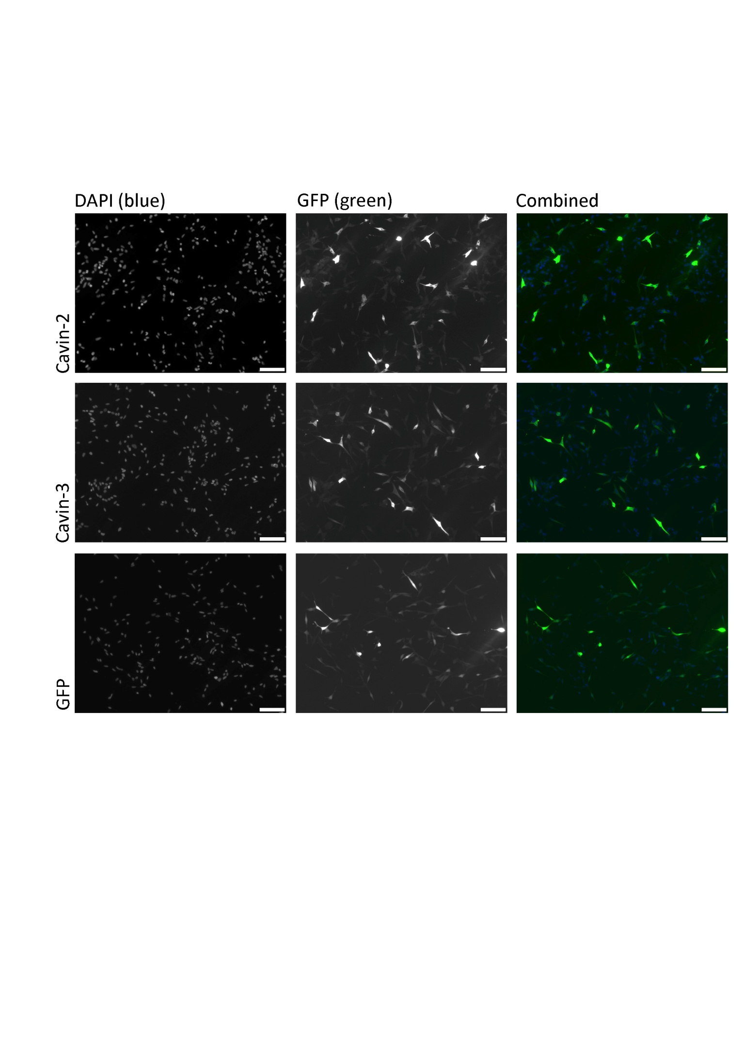
LNCaP transfections using lipofectamine 2000
~70% transfection
Lower expression than PC3 cells

Slide 18
Cavin-2 and Cavin-3 knockdown in DU145 cells
Day 1
Day 2
Day 3
Transfect with siRNA using lipofectamine
Second round of transfection
Plate cells in 6 well plate
Change media
Day 4
Use after 6 or 24 hours
Split cells to 2 wells each

Slide 19
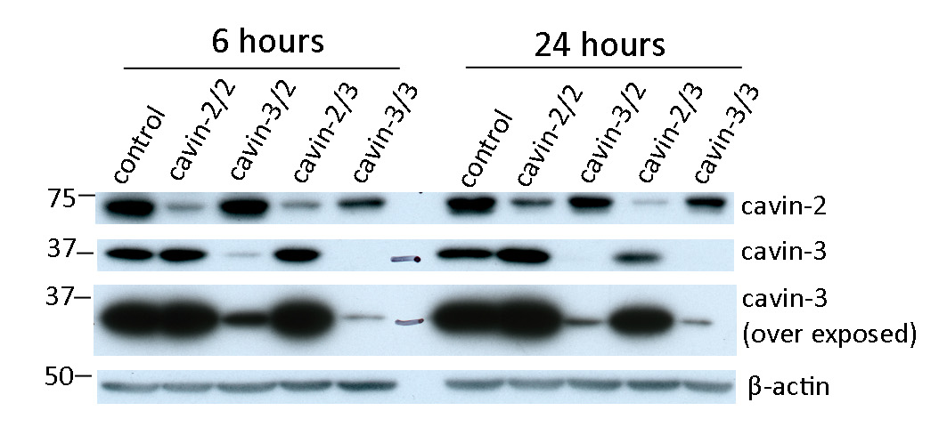
Cavin-2 and Cavin-3 knockdown in DU145 cells
Successful knockdown of both cavin-2 and cavin-3

Slide 20
GFP-trap experiment
Remove 20μg as starting material
Incubate for 1 hour on rotating wheel (4°c)
Add 1000μg to GFP trap beads
Collect cell lysate from 15cm dish of ~70% confluent cells
Wash to remove non-specifically bound proteins
Boil in sample buffer
Co-precipiate proteins bound to cavin-2 and cavin-3

Slide 21
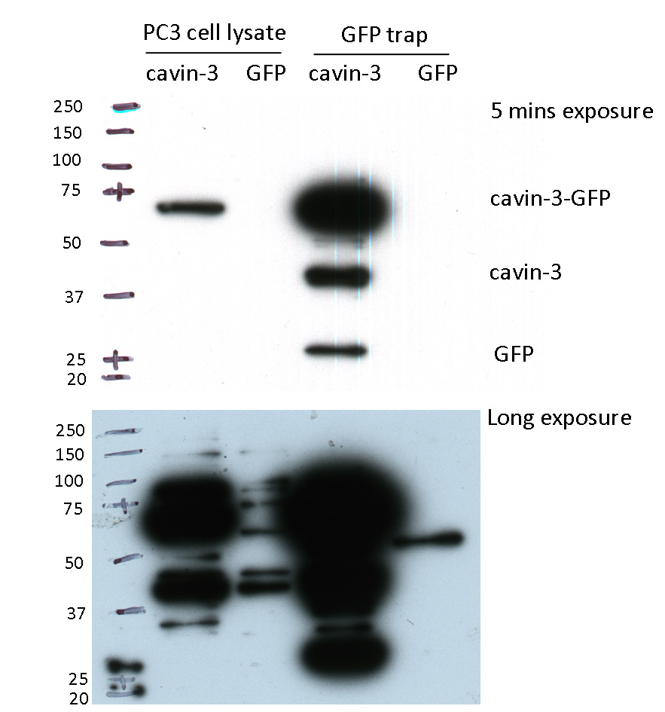
GFP-trap
No GFP in GFP control cell line

Slide 22
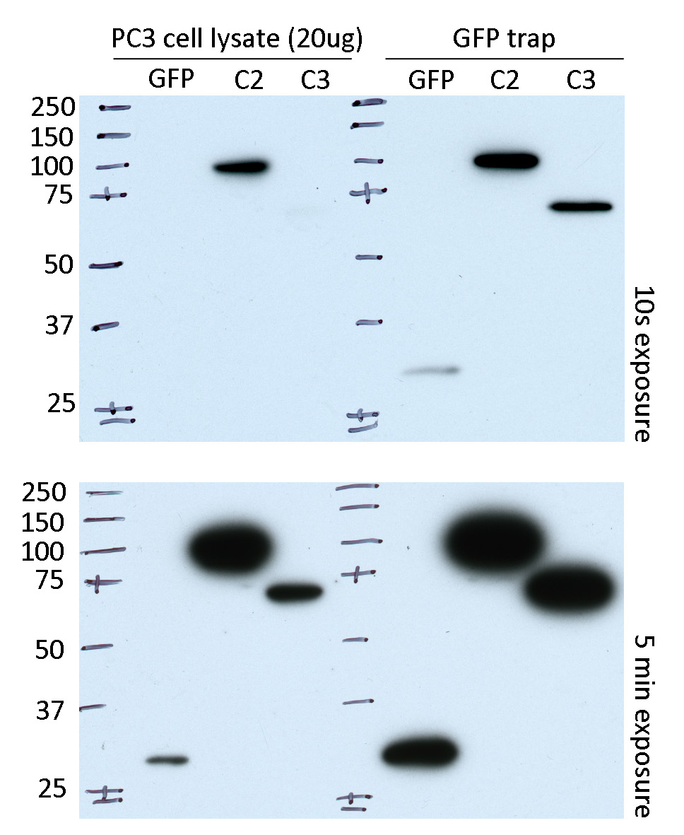
GFP trap with FACS sorted PC3 GFP control cells

Slide 23
Future experiments
Analysis of PC3 transcriptomics in cavin-2 and cavin-3 overexpressors
GFP-trap to determine cavin-2 and cavin-3 binding partners in PC3 cells
Functional assay validation in LNCaP overexpressors and DU145 cavin knockdowns

Slide 24

